Slide 1
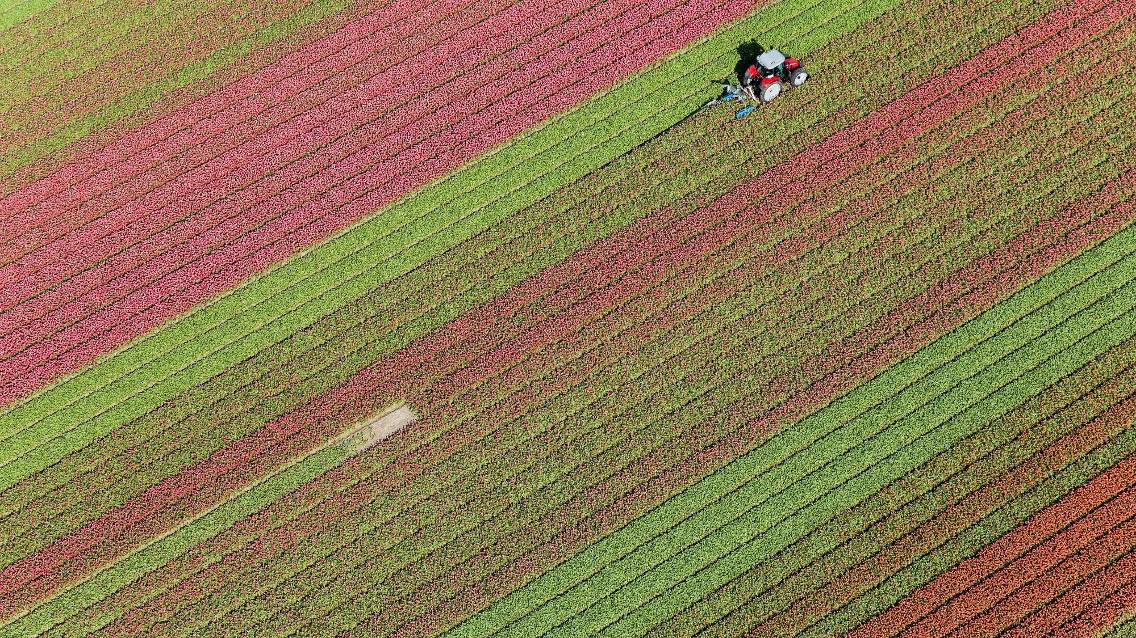
Farmer-Expert Management System
-OOPS

Slide 2
Agenda
Make farmer and an expert meeting easier
Let farmers know more about the choices of experts they have in their locality
Let farmers solve their problems faster
If Farmers need any guidance , they can get guidance from experts itself

Slide 3
Technologies used
java
java swing
planning to use google colab and python for cloud computing to make processing faster

Slide 4
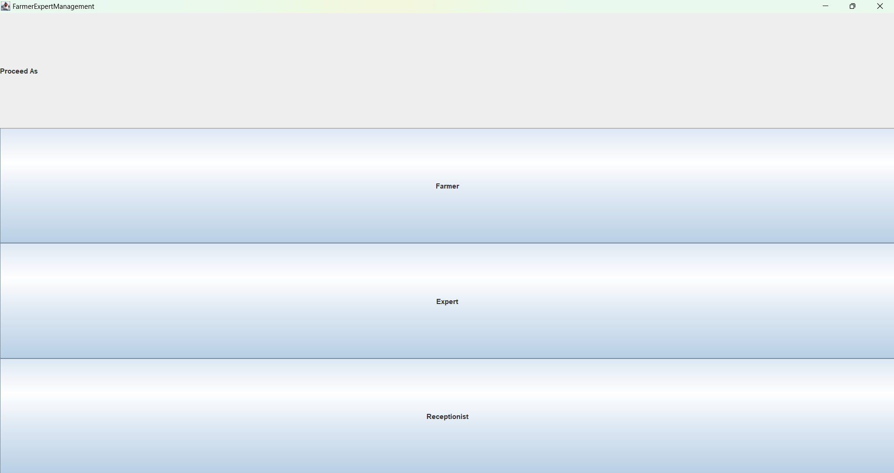
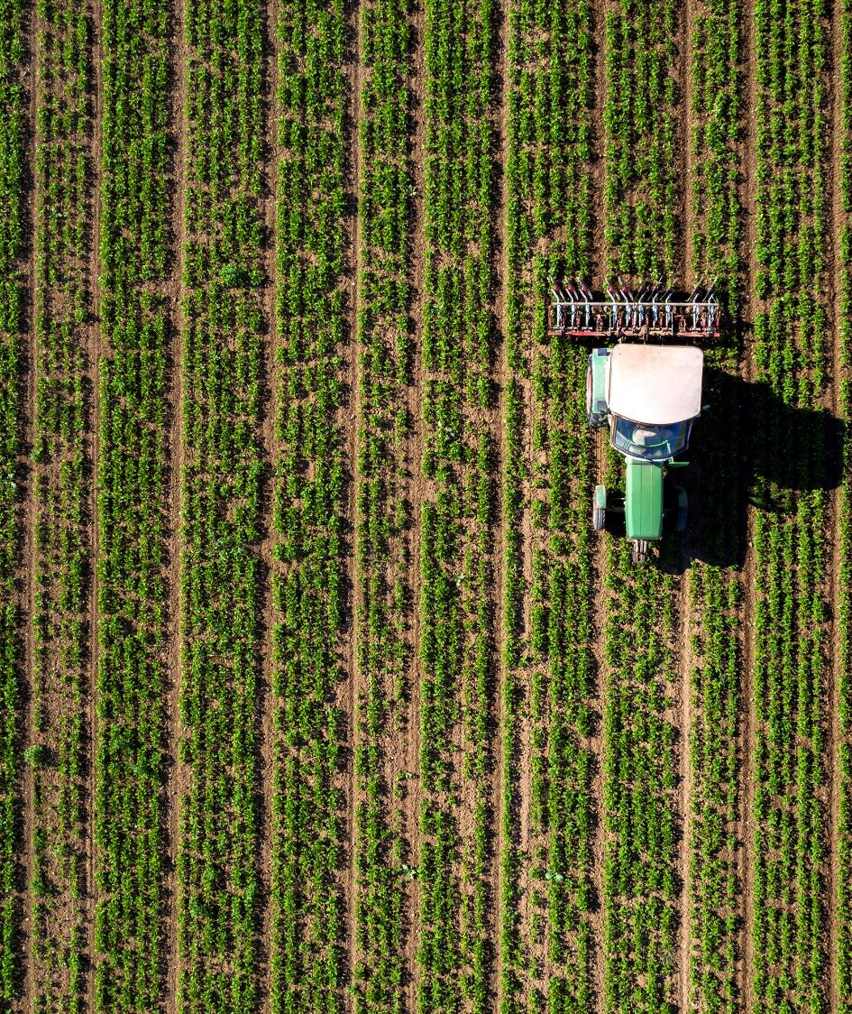
Main Page

Slide 5
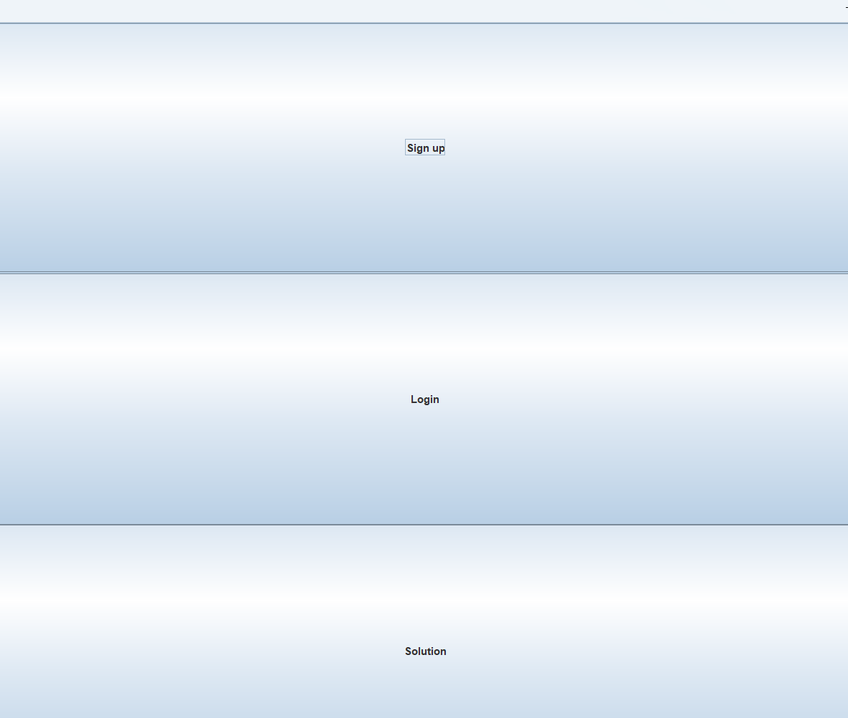
After proceeding as a farmer, he can signup if he is not a member of our database, Login to register his problem or click solution to know solution for his problem.

Slide 6
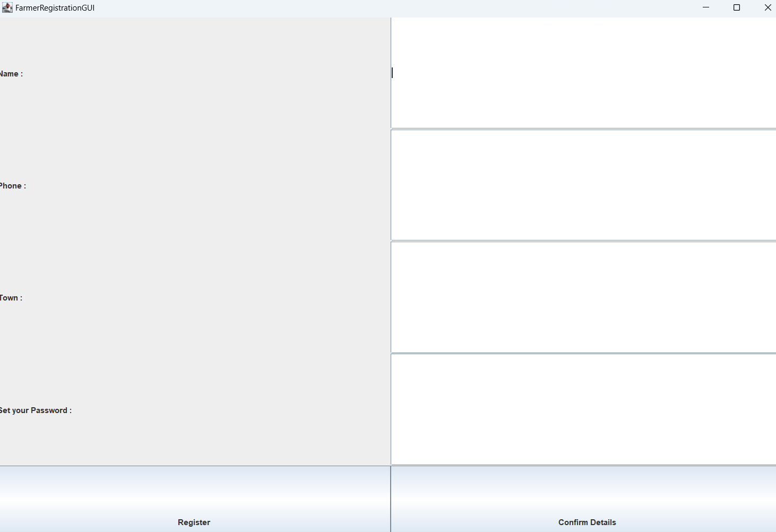
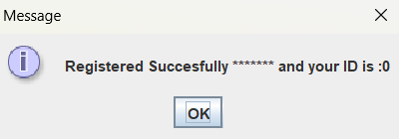
Farmer Registration Page
Registering from this page , a farmer becomes member of our “cfdb”, company farmer database.
This farmer will be given an id.
from now on he can login into our page and share his problem and correspondingly our management System will find him a good expert and book an appointment with him.

Slide 7
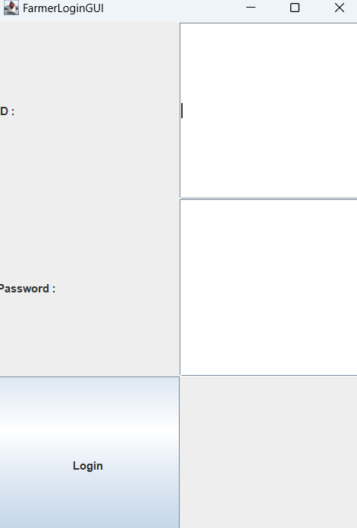
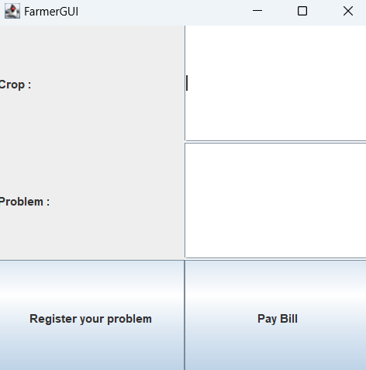
Farmer Login GUI and FarmerGUI
Registered Farmers can login through FarmerLoginGUI
Logged in farmers can register their problems though FarmerGUI

Slide 8
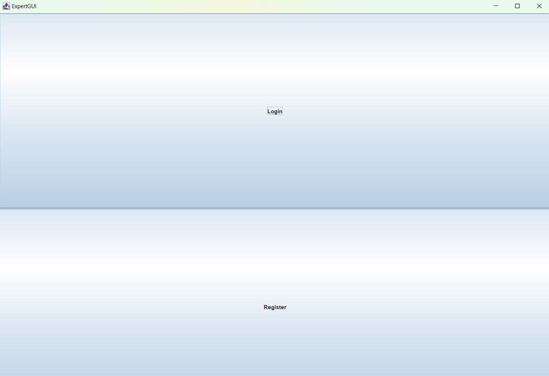
Expert page
In this page an expert can login if he or she has already registered ie; he/she is in our “expert-database”
If he has any cases assigned by our receptionist, they will be shown here
He has to note down all cases and act accordingly

Slide 9
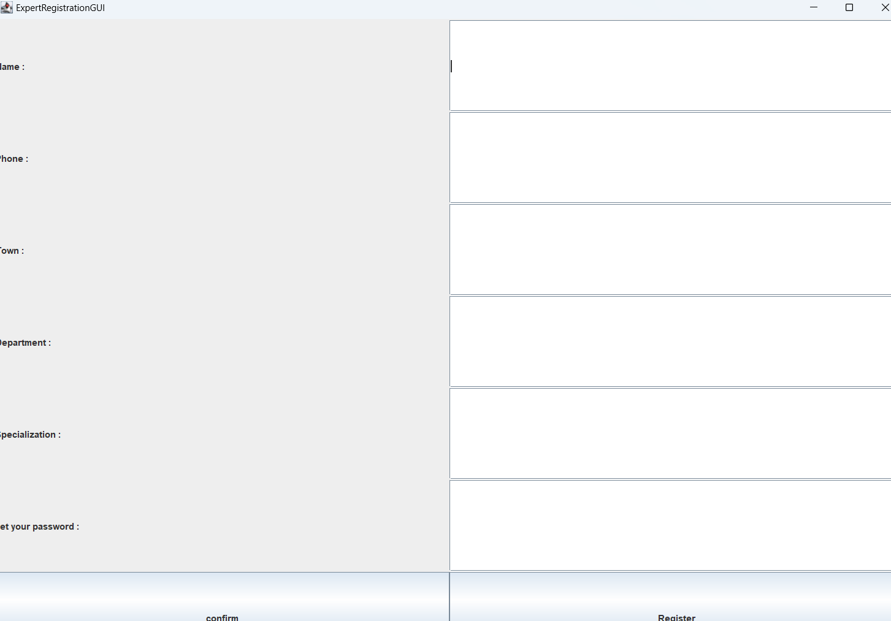
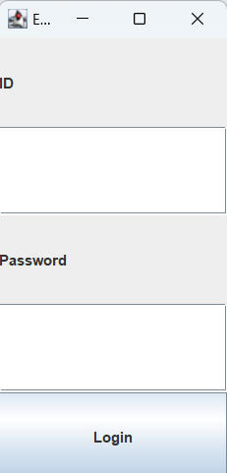
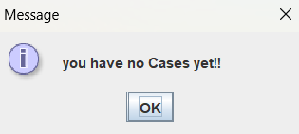
Expert GUI’s
As an expert you can login if you are already registered.
Esle you have to Register yourself by specifying your Dept., and Specialization
if you logged in you will be shown what are the cases you have to deal

Slide 10
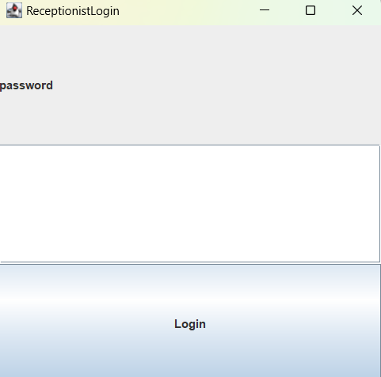
Receptionist Login Page
Receptionist is the main worker of this application.
He has the job of booking slots and sending messages to farmer and to the expert in the expert database corresponding to his problem.
we get this page after proceeding as a receptionist

Slide 11
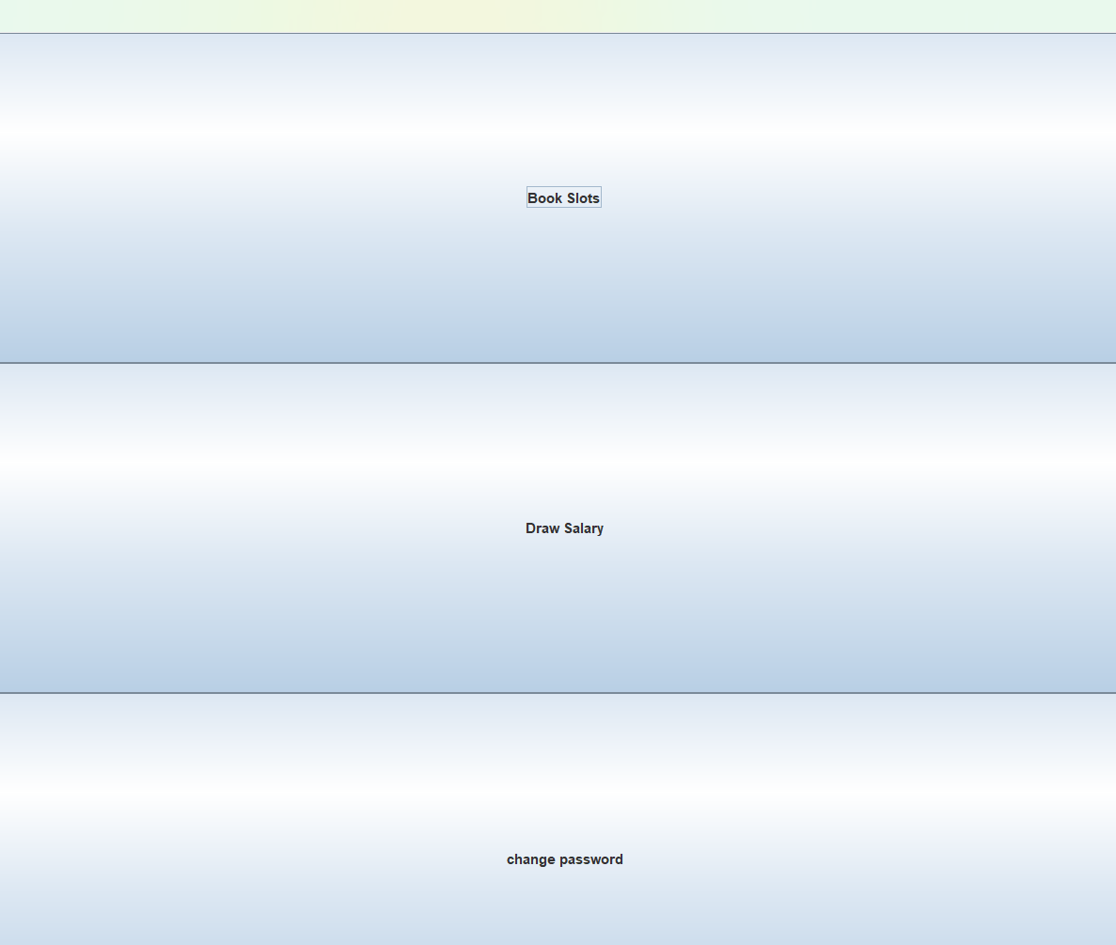
Receptionist page
As we can see, a receptionist has to book slots and also he has to change password(frequently).
Booking slots is the main work of the Receptionist.
If the Receptionist booked slots , messages will be sent to Farmers and the corresponding expert specialized in the field of their problem.

Slide 12
Thank You
P Jaswanth Royal(CS23B034)
S.K Danish Dada(CS23B047)
cs23b034@iittp.ac.in
cs23b047@iittp.ac.in

